Slide 1
Ridgehead K-Fuze CMS Overview
Cloud Based Customer Management Solution

Slide 2
About Ridgehead Software
Ridgehead Software is a US based software development company with on and off-shore resources providing our clients with a balance of top-flight customer services and competitive off-shore development pricing.
In addition to custom software development, Ridgehead developed the K-Fuze CMS solution for companies looking to provide a full service customer care solution for their users.
Ridgehead also does mobile, web portal, and application custom development.

Slide 3
K-Fuze CMS Overview
K-Fuze CMS is a Customer Management Solution (CMS) that includes the core building blocks for small-to-medium (SMB) organizations to manage all their customer care interactions, their customers, their content, and their entire customer care web portal - for internal, external, partner, and channel customers.
Use K-Fuze CMS to create a complete customer care web site solution for an organization to facilitate a turn-key customer care and content management system.
Easily customize K-Fuze to create a unique customer care web site, and extend it to integrate with 3rd party systems for a complete custom solution.

Slide 4
K-Fuze CMS Core Functionality
K-Fuze CMS Components
Customer Relationship Management
Content, Knowledge & File Management System
Complete Web Site Portal & Management System
Request, Ticket and Contact Management System

Slide 5
K-Fuze CMS Cloud/Enterprise Offerings
K-Fuze CMS Enterprise offering allows companies to install K-Fuze CMS on servers in their own data center.
Hosted in clients secure data center.
Database resides in clients complete control.
Company controls access to K-Fuze CMS application.
K-Fuze CMS Cloud offering is hosted completely in the Microsoft Azure cloud using the best possible cloud based solutions and functionality.
Continuous builds and updates
Scalable load balancing setup
Highly secure to satisfy all customer environments

Slide 6





K-Fuze CMS Technology Backbone
Microsoft Windows
IIS Web Servers
ASP. NET 4.x
SQL Server database
Apache Solr
Microsoft Azure for SaaS deployment
Bootstrap compliant for rendering UI on mobile devices
UI runs on Windows, Apple Mac and Linux
Supports all popular browsers and resolutions and mobile devices

Slide 7
K-Fuze CMS Authentication Providers
K-Fuze CMS
K-Fuze CMS native authentication provider
Google
Leveraging OAuth 2.o
Facebook
Leveraging OAuth 2.o
Active Directory
Leveraging Microsoft Active Directory (AD)
K-Fuze CMS Membership Provider manages roles and permissions

Slide 8
K-Fuze CMS High Level Functionality
Functionality
Customers
Web Site
Authentication
Import/Export
Ticketing
Email Listener
Email Notifications
Reporting
Web Service API Library
Content Management
Dashboards
Globalization
Staff Onboarding
Workflow
Event Handling
Glossaries
Rich library of modules for performing all aspects of customer service management.
Manage core customer interactions relating to content and contacts.
Web Service API Library available for full integration into, and out of, K-Fuze CMS from 3rd party systems.

Slide 9
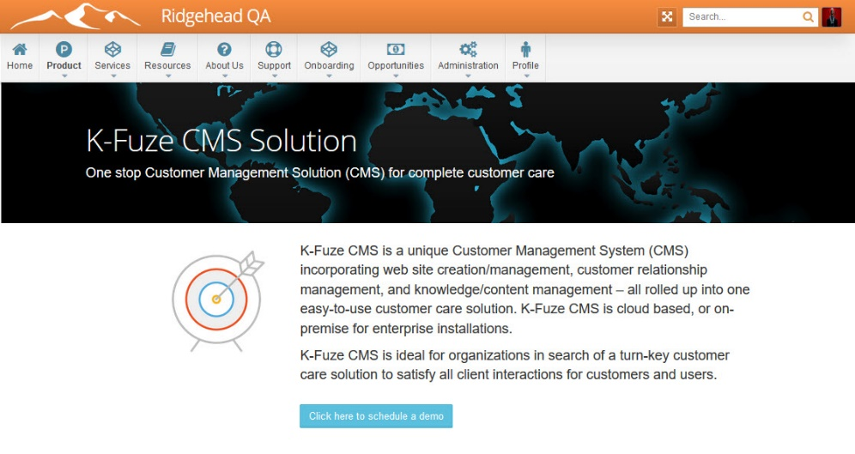
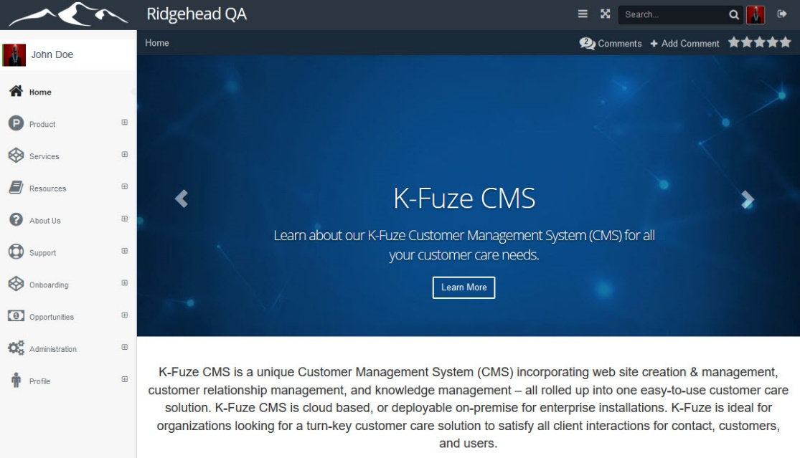
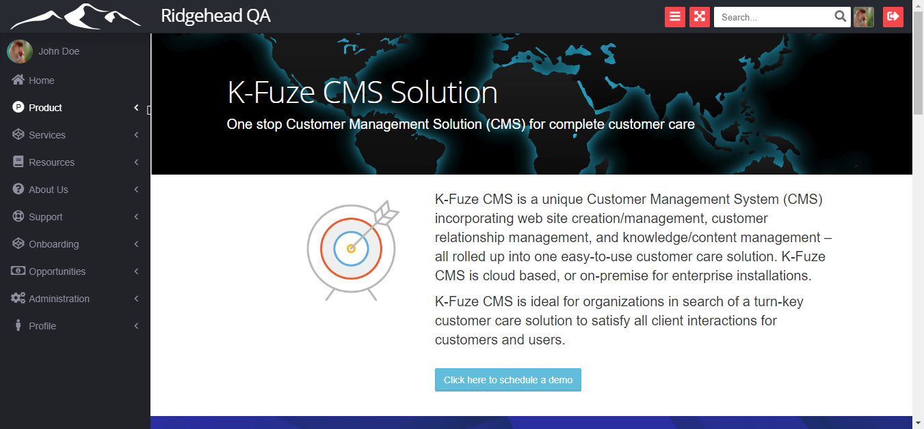
K-Fuze CMS Customizable Web Portal
Multiple themes
Mobile friendly
Top & left menu navigation
Customizable menus
Customize styles
Add company logo and branding

Slide 10
K-Fuze CMS Framework Features
Customizable web pages
Custom sitemaps/navigation
Multiple authentication providers
Role based permissions
WYSIWYG web pages
Highly configurable ticketing solution
Multi-lingual
Rich content and web management system
Browsing & searching of site
Email support for notifications and events
Workflow Engine
Dashboards and Reporting
Rich set of APIs for easy integration

Slide 11
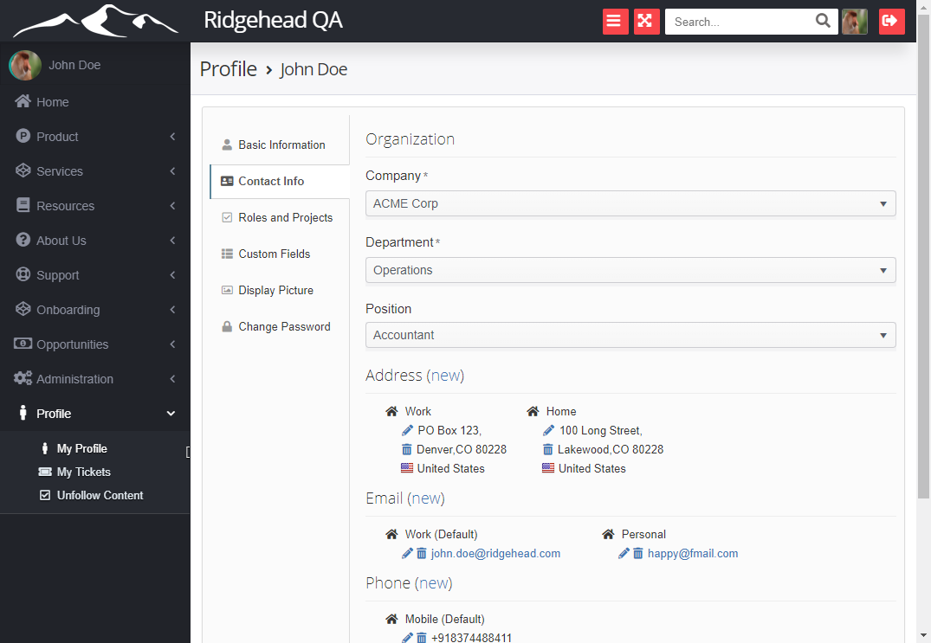
K-Fuze CMS Customer Management
Track all customer contact info, including; phone numbers, email addresses, IM’s, web links, social media, etc.
Extend customer data by adding custom fields such as Text, Text Area, Date, Datetime, Time, Dropdown, Radio Button, Checkboxes, etc.
Encrypt key customer data
Allow customers to login to portal
Audit trail of user and customer activities
Customers can search and browse for content
Customers can log and track their own tickets
Email notifications for tickets and content

Slide 12
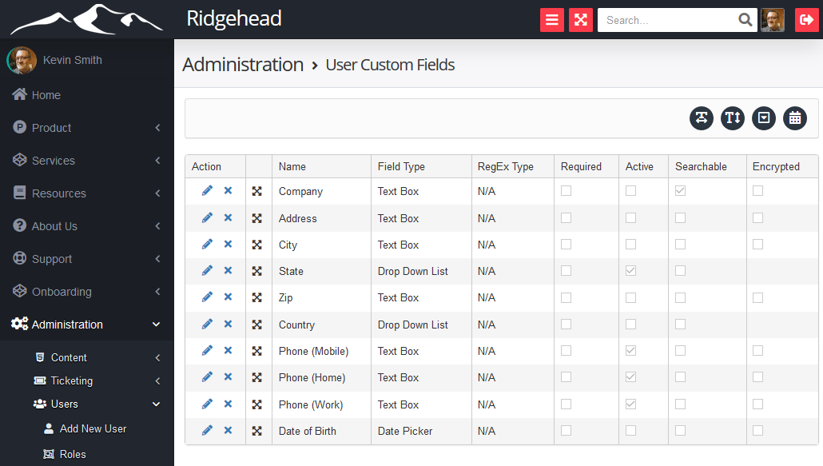
K-Fuze CMS Customer Management
Administrative UI for editing user custom fields
Extend customer information that is stored by adding custom field controls, including; text box, text area, date, datetime, time, dropdown.
Encrypt text data on a field-by-field level.
Limit visibility to fields based on the logged in users role.
Allow users to edit their own data, or restrict to internal user roles.
Apply REGEX masks to text boxes to restrict how data is entered into these fields.
Re-arrange the layout of the customer fields.

Slide 13
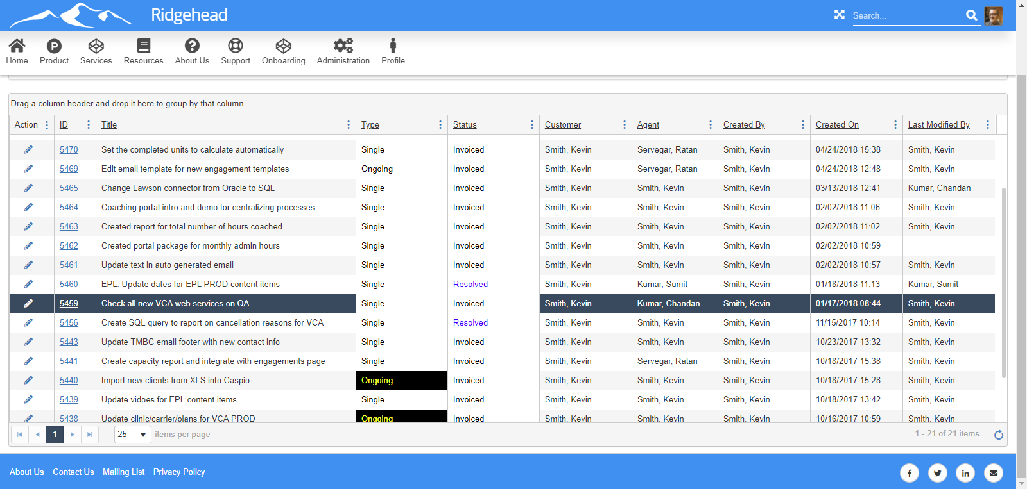
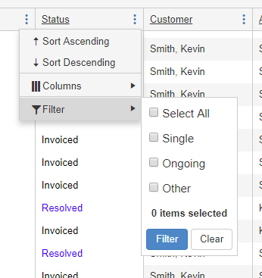
K-Fuze CMS Contact Management
Rich ticket list interface
View all tickets for all ticket projects, or only tickets for specific projects
Create & save custom filtered views
Create different views for different roles
Group, sort, filter, rearrange all columns
In-grid editing of tickets
Colorize grid cells based on dispositions
Export tickets to Excel
Rich filter by any column(s) - and then save the filtered results as a view.

Slide 14
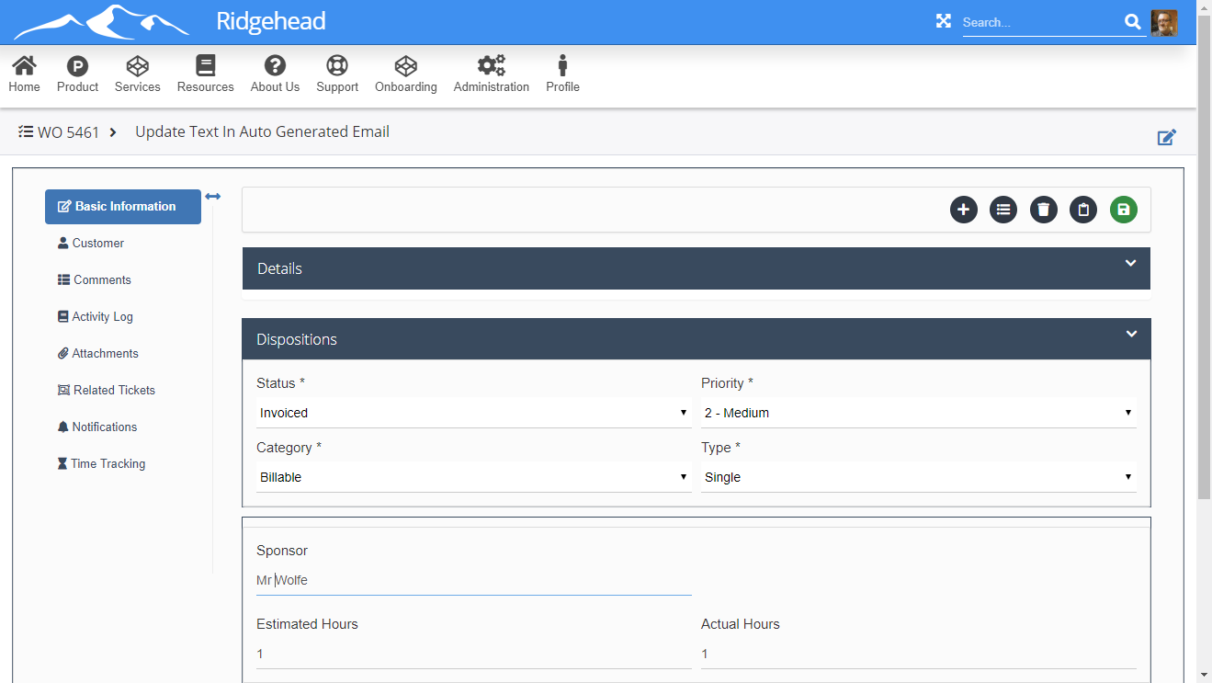
K-Fuze CMS Contact Management
Fully customizable ticket page
Rich-text editing of details/comments
Copy/move tickets between projects
Roles based customizable fields; text boxes, drop-lists, date pickers, etc.
Audit trail and ticket history
Attach files to tickets
Relate tickets together
Custom email notifications by activity
Time and effort tracking
Custom ticket notification lists

Slide 15
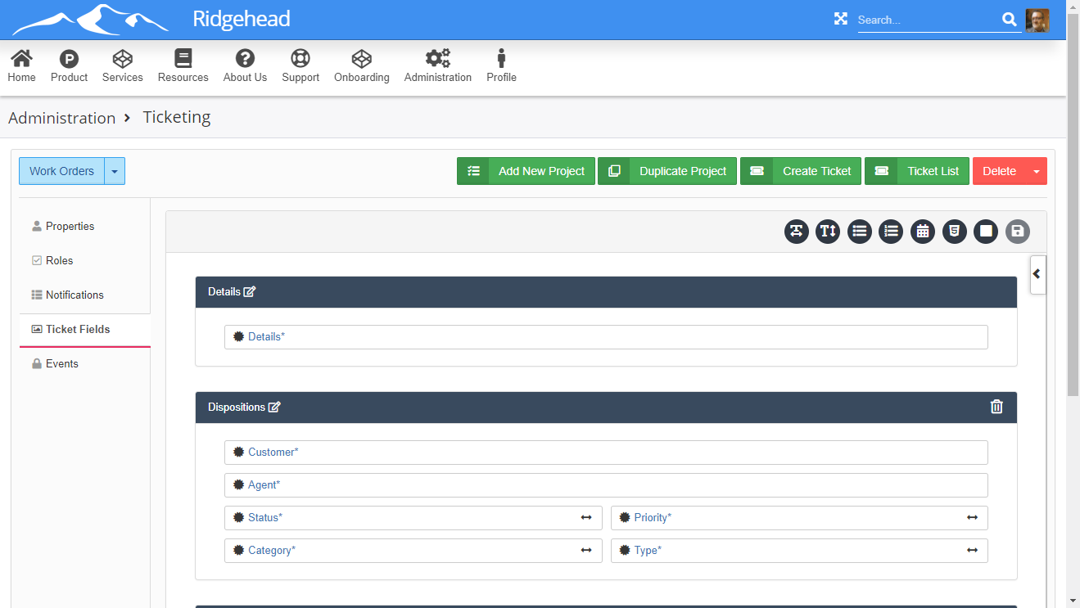
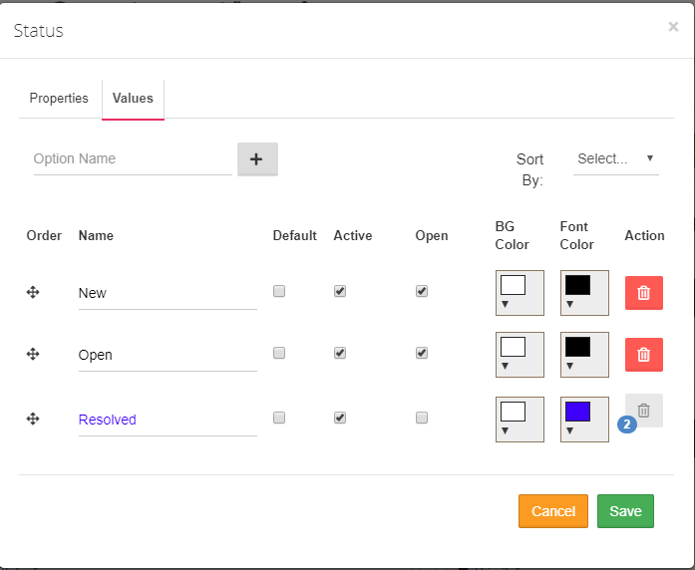
K-Fuze CMS Contact Management
Administrative UI to manage ticket projects
Manage multiple ticket projects
Roles based customizable fields; text boxes, drop-lists, date pickers, etc.
Turn features on or off based on project
Drag & drop UI to edit ticket page layout, colors, lookup values, etc.
Support for email generated tickets
Encrypt certain key data
JavaScript events and workflows for tickets
Ticket API for easy integration

Slide 16
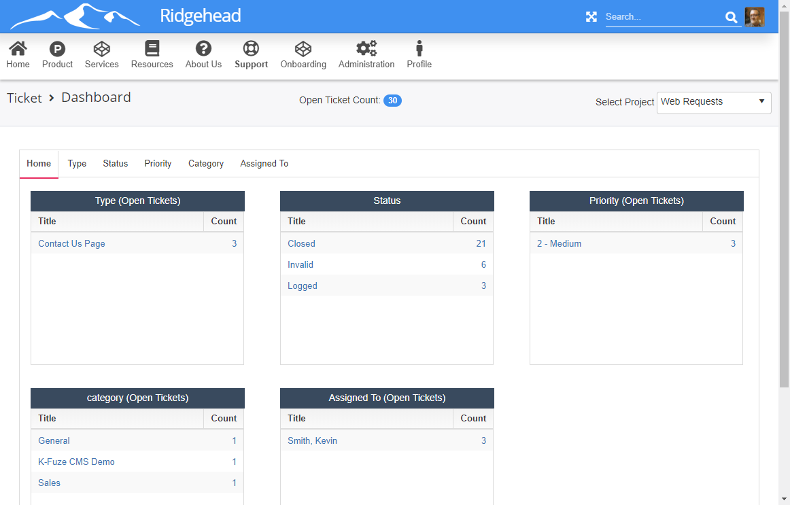
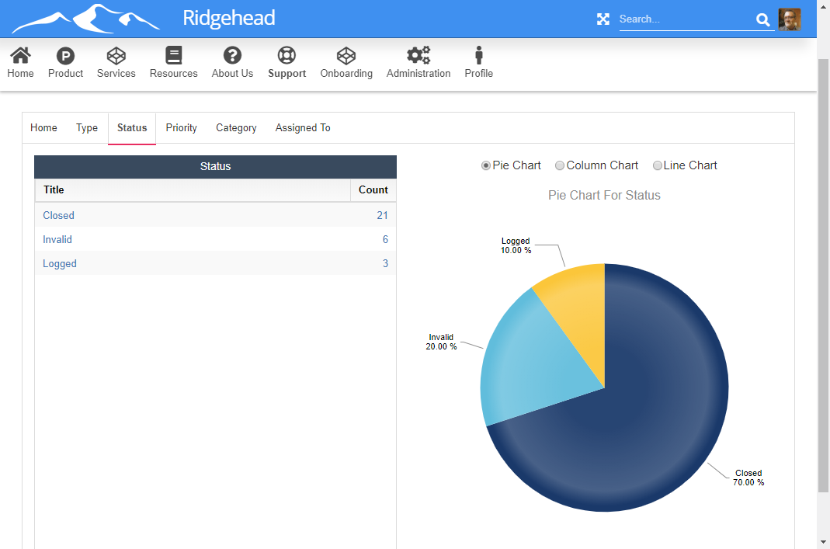
K-Fuze CMS Contact Management
Ticket Dashboard for instant analysis of all open tickets
Drill down reporting
Link through to ticket list page to evaluate ticket details
Graphs and charts for visual view of data
Report on all lookup and multiselect fields

Slide 17
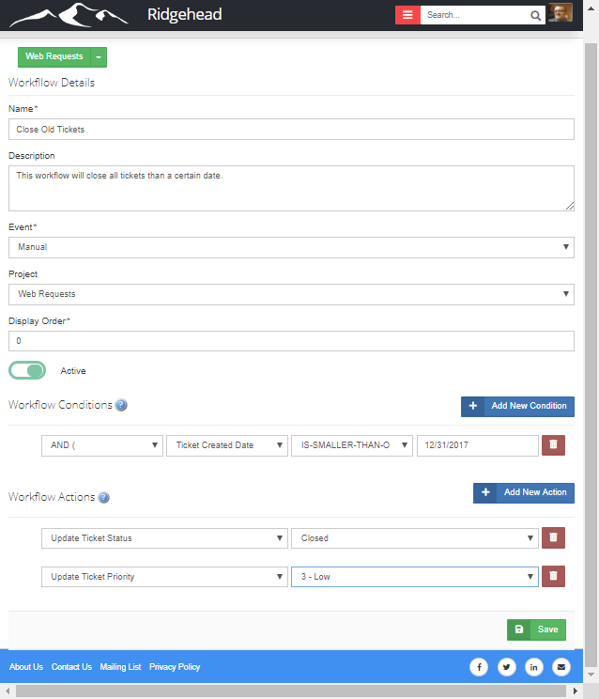
K-Fuze CMS Contact Management
Separate Ticket Workflows for each ticket project
Workflow actions that are triggered by ticketing events, including; ticket create, ticket edit, ticket create/edit, ticket comment – as well as manually triggered workflows.
Create as many ticket conditions as you want to when the workflow will be executed.
Create as many actions as you want for updating tickets.
Generate optional emails when ticket workflow is triggered.

Slide 18
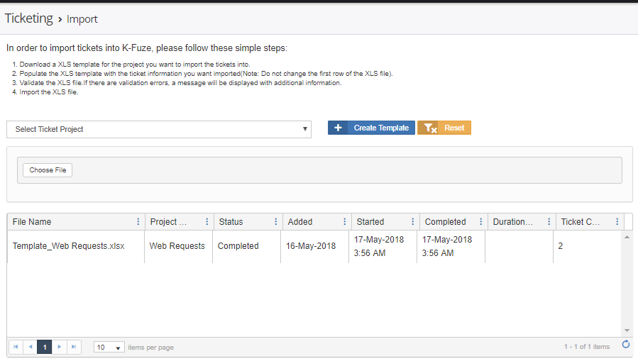
K-Fuze CMS Contact Management
Bulk Ticket Importing functionality
Workflow actions that are triggered by ticketing events, including; ticket create, ticket edit, ticket create/edit, ticket comment – as well as manually triggered workflows.
Create as many ticket conditions as you want to when the workflow will be executed.
Create as many actions as you want for updating tickets.
Generate optional emails when ticket workflow is triggered.

Slide 19
K-Fuze CMS Content Management
Multiple content formats
HTML based content authoring
Attach files as content items
Link to other web site pages
News and events broadcasting
Limit content based on users role
Full-text searching of content
Advanced filtering of search results
Optional content rating and commenting
Threaded commenting for content
Follow content you are interested in
Glossary of terms support
Content duplication
Content categorization & keyword metadata
Content list with filtering, views, reporting
Full content history with roll backs
Content view and edit history
Content dashboard for reporting
Email notifications for events
Multilingual support

Slide 20
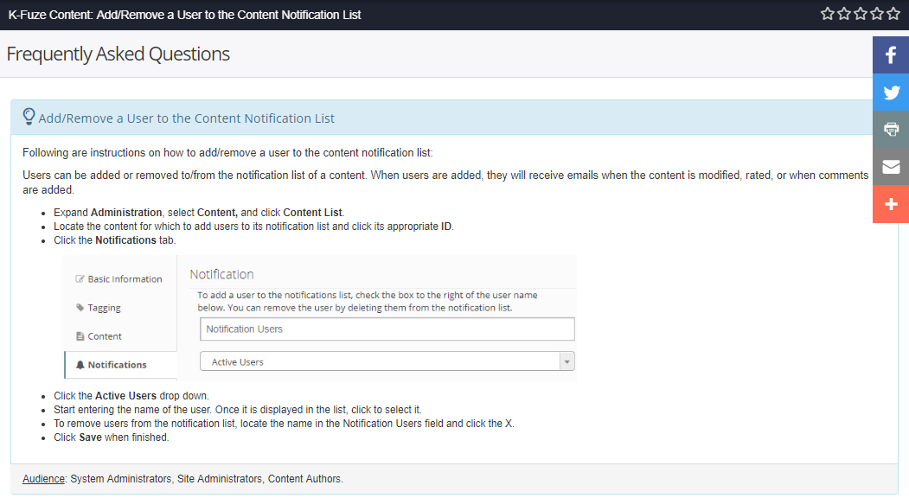
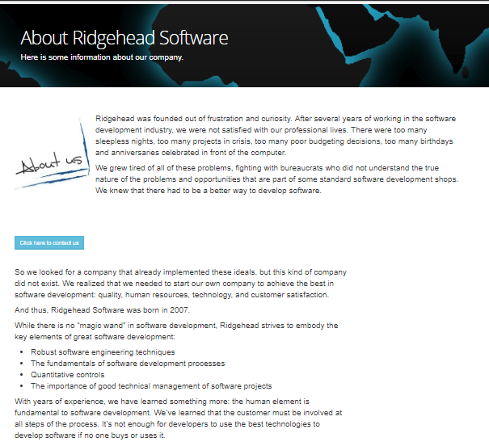
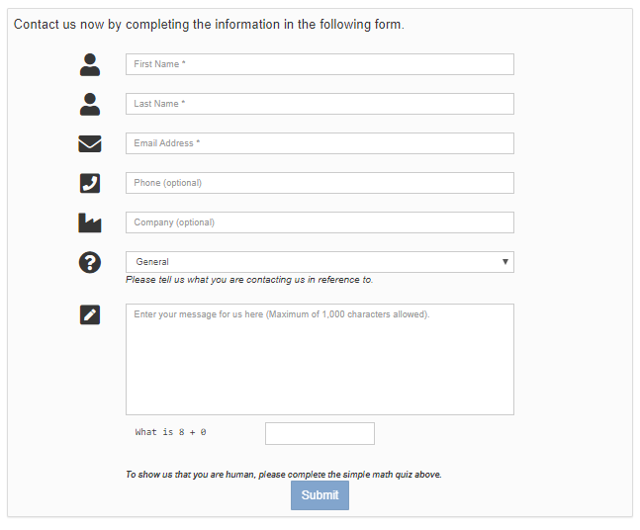
K-Fuze CMS Content Management
Create rich content pages for all purposes, including graphics, video’s, FAQ’s, etc.

Slide 21
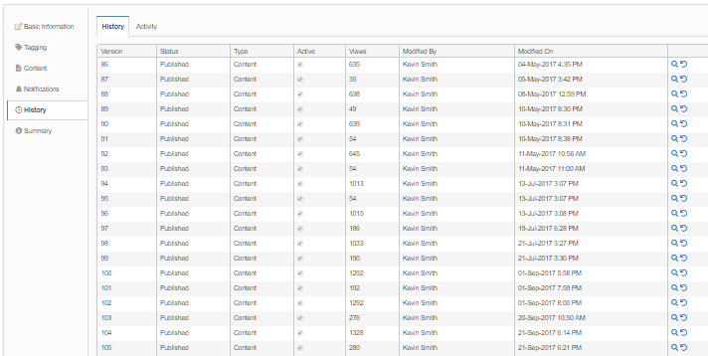
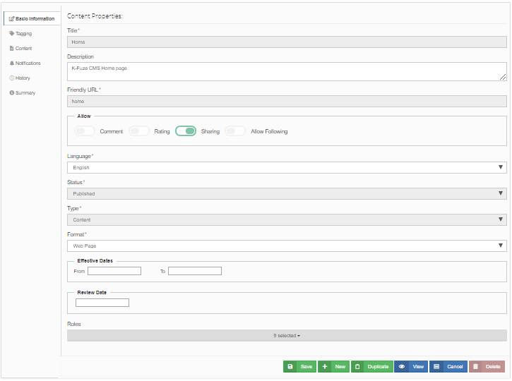
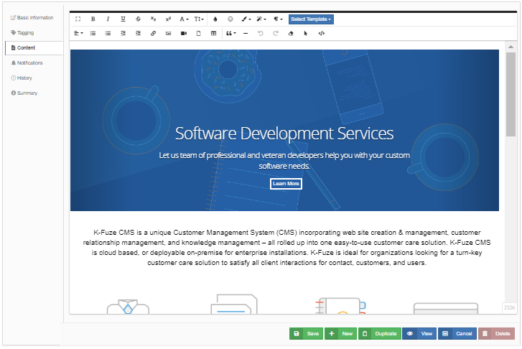
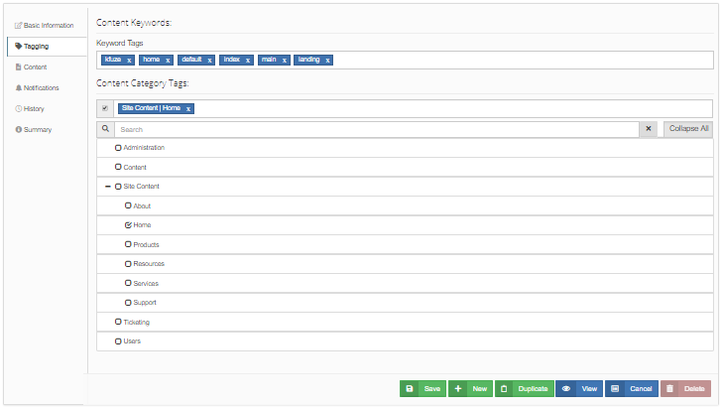
K-Fuze CMS Content Management
Robust content editing functionality.

Slide 22
K-Fuze CMS Web Management
Develop entire support site in K-Fuze
Create all site web pages using CMS
SEO friendly naming conventions
Create menu and footer sitemap navigation
Rich-text editing of all web pages
Track usage information for page views
Google (or other) analytics support
Include favorite web analytics tools
Include social media links and sharing to pages
Custom footer support
Multiple site themes along with horizontal and vertical site navigation
Limit page access by role
Manage user registration and authentication to site
Manage user permissions to what functionality users can perform on site
Change any-and-all labels on site.
Provide searching for pages and content (simple and advanced)
Embed 3rd party functionality into site
Create a complete customer care site!

Slide 23
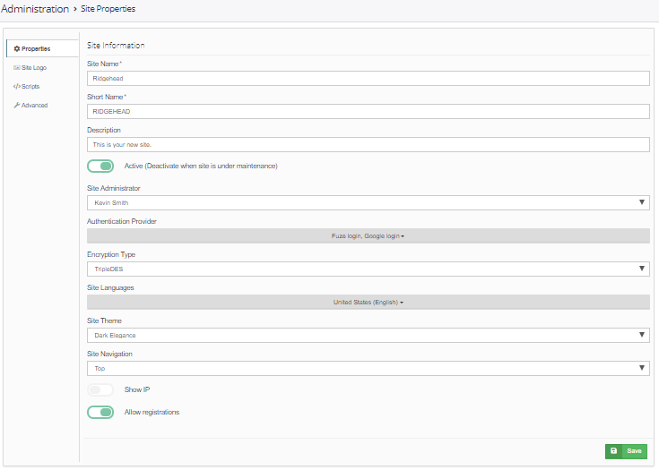
K-Fuze CMS Web Management
Site Management UI for complete administration.
Change theme and menu layout for site.
Set logo for site
Add custom scripts to be executed on pages.
Set encryption for site.
Configure authorization provider(s) for site.
Update site configurations.

Slide 24
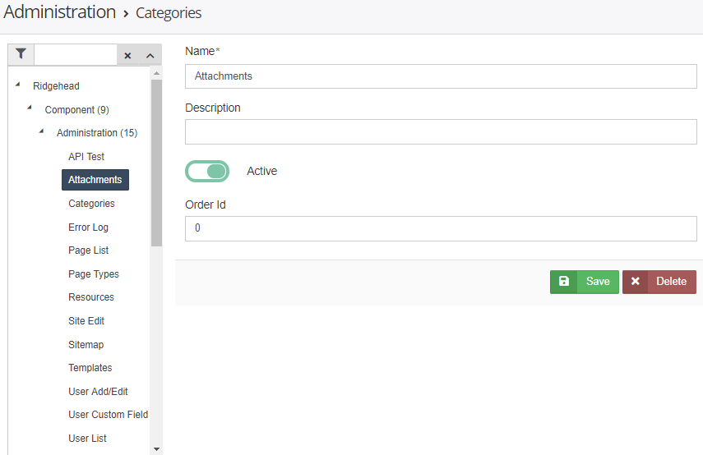
K-Fuze CMS Web Management
Complete Category Management system.
Categories can be used as lookup fields for both ticketing and customers.
Create multi-level category structures.
Categories include name/value pairs.

Slide 25
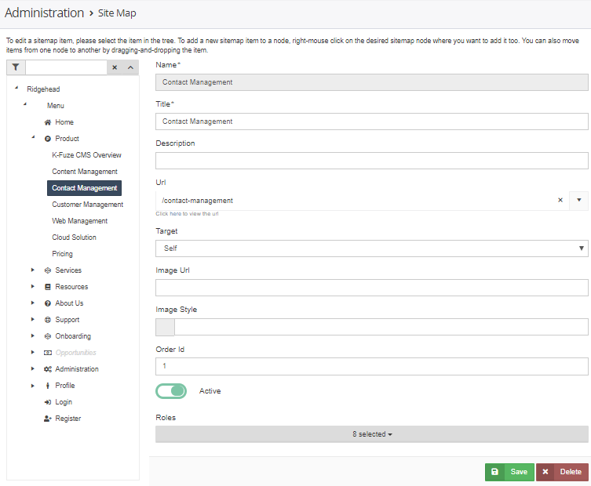
K-Fuze CMS Web Management
Create Menu Navigation for site
Sitemap items are roles based to display specific menus to specific users based on their roles.
Add custom icons for sitemap items.
Link content, and other, pages to menu items.
Create, edit, delete menu items on-the-fly.
Re-arrange menu items in an order.
Create multi-level men structures.

Slide 26
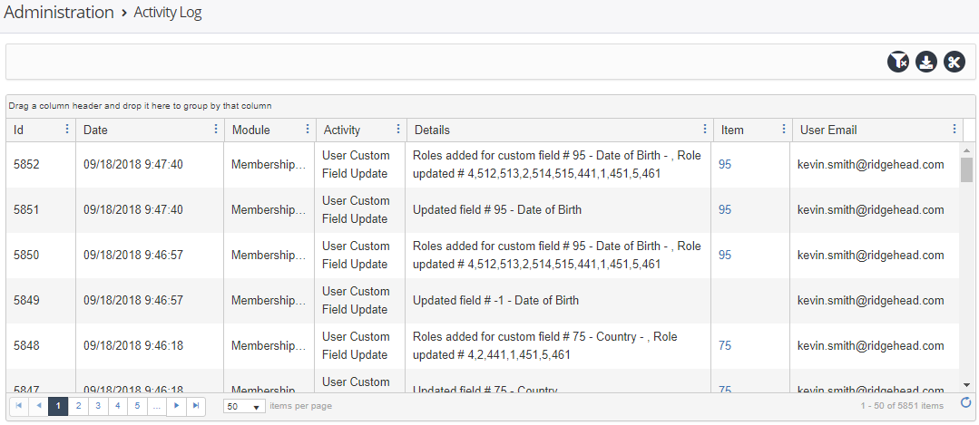
K-Fuze CMS Web Management
Activity and Error logging.
View system activity and error logs within the site.
Filter logs for specific entries.
Export logs.
Clearing of logs limited to system or site administrators.

Slide 27
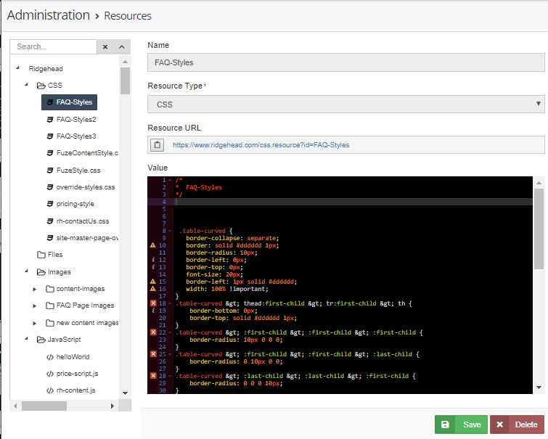
K-Fuze CMS Web Management
Complete Resource administration system.
Site resources include images, files, videos, CSS,& JavaScript.
Share resources are cached for optimum performance.
Include resources in content pages.
Organize resources for easy management.
Create resources via content edit pages, or in resource management page.

Slide 28
K-Fuze CMS Web Services API Library
Ticketing
Ticket List
Users
User List
Content
Ticket Add
Ticket Edit
Comment Add
Attachment Add
User Add
User Edit
Content List *
Content Add *
Content Edit *
Category List
Category Add *
Category Edit *

Slide 29
Conclusion
Ridgehead Software, Inc.
225 Union Blvd.
Suite 150
Lakewood CO 80228
United States of America
www.ridgehead.com
Kevin Smith
kevin.smith@ridgehead.com
+1 (720) 280-0067 m
Ridgehead Software Inc. is committed to partnering and working with companies who are intimately involved in the customer care process, who value the way they treat their customers, and who can drive requirements and assist with the evolution of the K-Fuze CMS solution.

